Slide 1
What is Metaverse?
A Briefing on Metaverse.

Slide 2
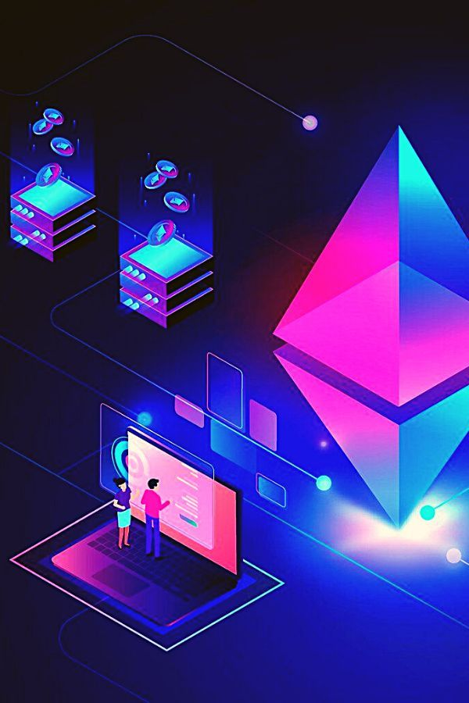
Imagine you meet your family,also friends in a 3d world build artificially.
You do everything you want to do in real life like shopping,travelling etc.
Just by using a headset usually called VR.
Muhammad Hammad Shah

Slide 3
Metaverse will be the future of next generation.

Slide 4
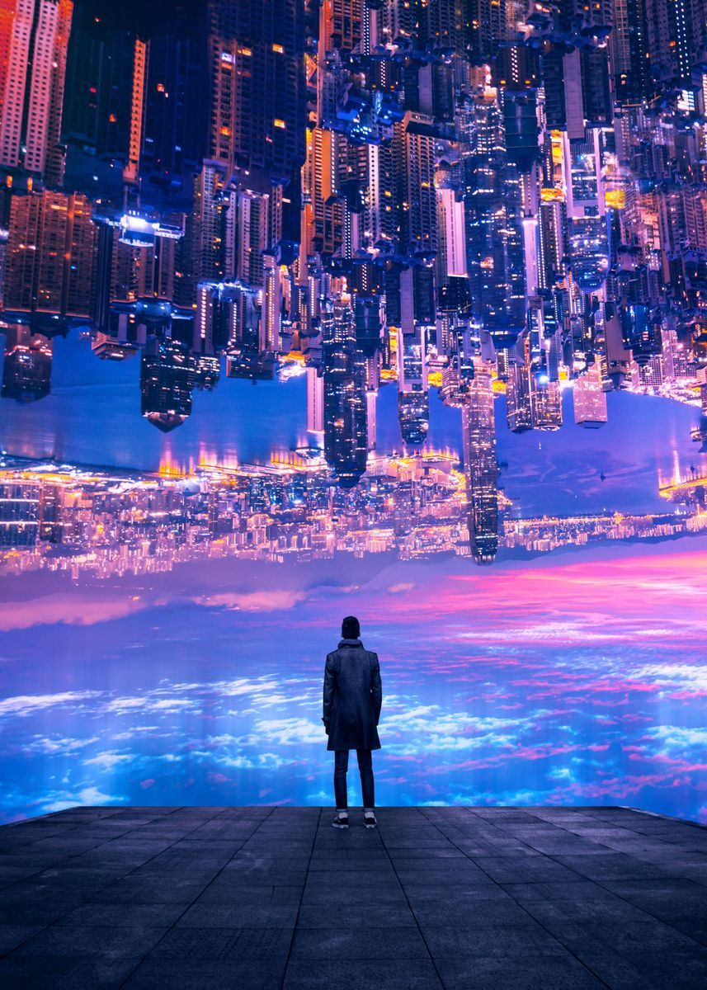
Metaverse is basically composed of two words
Meta means Beyond
Verse is use for universe
Means you can do anything in that universe build artificially beyond the thinking
It is not not like Multiverse but similar to it.
Most scientist also discussed it.

Slide 5
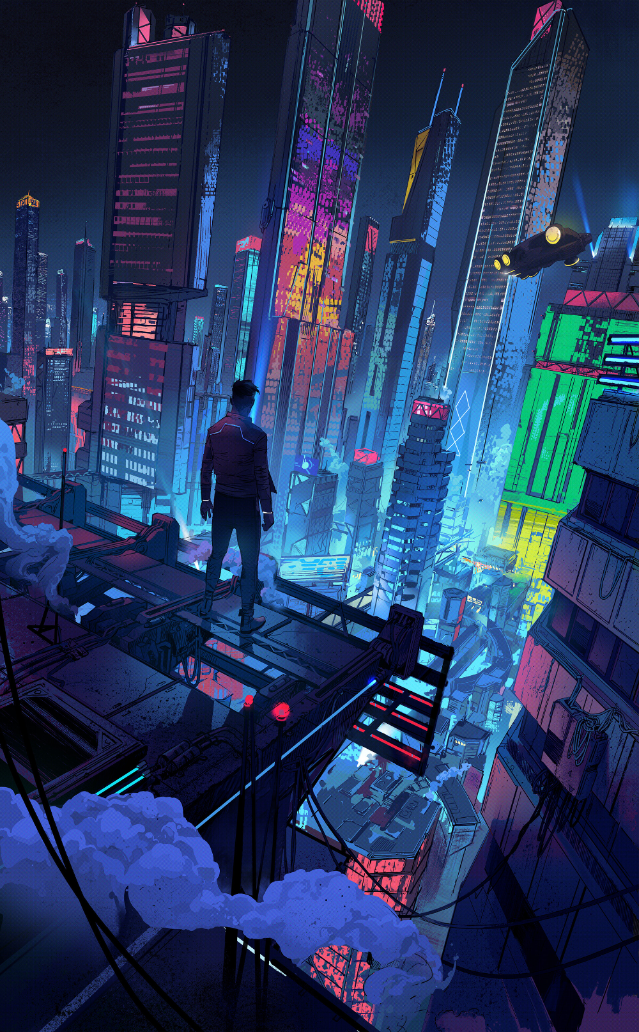
Imagine you watch a movie or a match on tv but now you experience it like in a real world using VR.

Slide 6
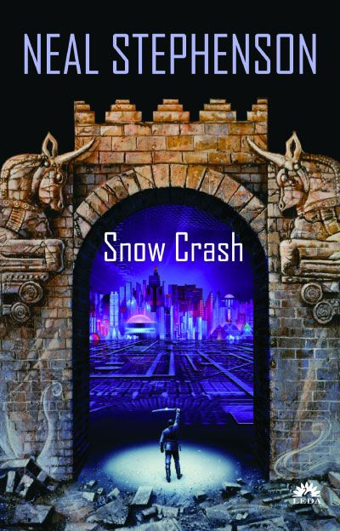
Neal Stephenson an American writer in his book SNOW CRASH he compose Metaverse for the 1st time in 1992.
He composed that people will start living in virtual world from there room when the real world have been destroyed.

Slide 7
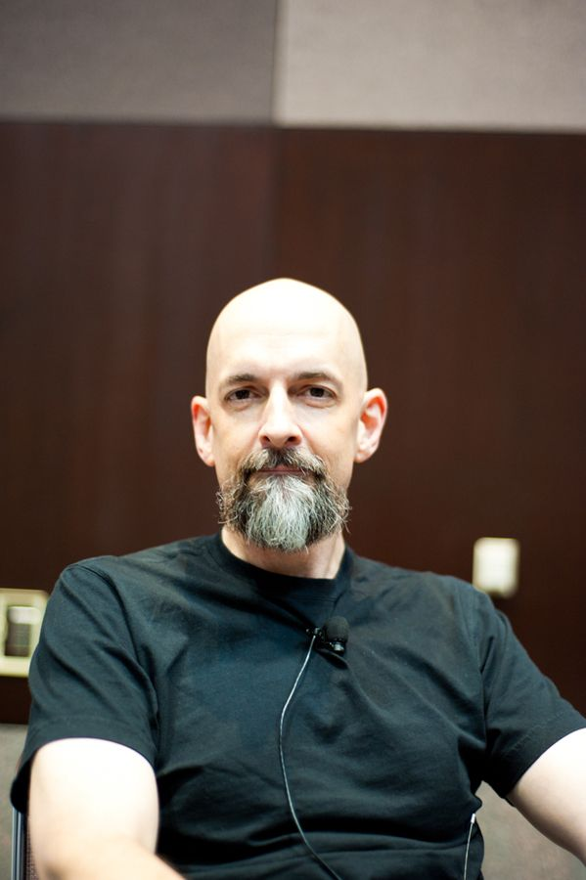
Neal Stephenson inspired a lot as As with Vannevar Bush, Stephenson’s influence on modern technology only grows with time, even if he is mostly unknown to the public. Conversations with Stephenson helped inspire Jeff Bezos to found the private aerospace manufacturer and suborbital spaceflight company Blue Origin in 2000, with the author working there part-time until 2006, when he became a senior advisor to the company (a position he still holds). As of 2021, Blue Origin is considered the second most valuable company of its kind, ranked only behind Elon Musk’s SpaceX. Two of the three founders of Keyhole, now known as Google Earth, have said their visions were informed by a similar product described in Snow Crash, and that they once tried to recruit Stephenson to the company. From 2014 to 2020, Stephenson was also “Chief Futurist” at Magic Leap, a mixed reality company that was also inspired by his work. The company later raised over half a billion dollars from corporations including Google, Alibaba, and AT&T, attaining a peak valuation of $6.7 billion, before struggles to realize its vaulting ambitions resulted in a recapitalization and the departure of its founder.
THE METAVERSE by MATHEW BALL

Slide 8
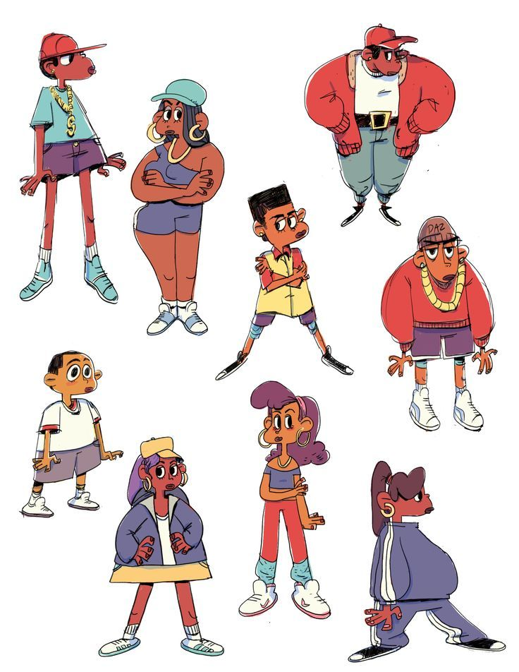
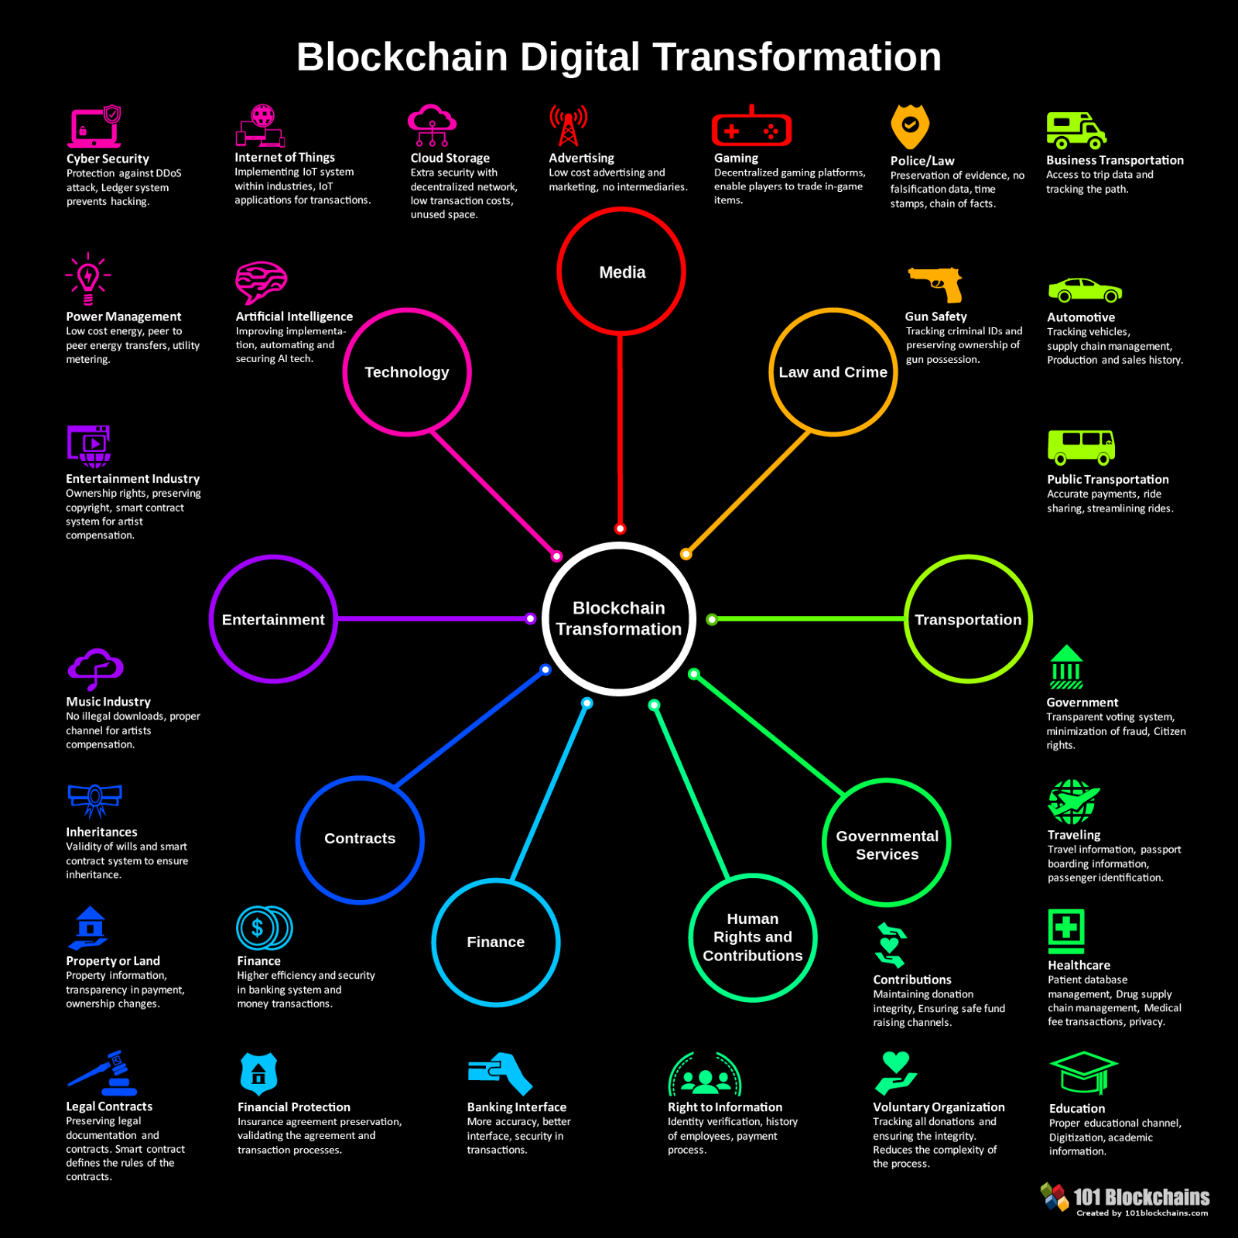
Metaverse will be composed of:
Nft
Blockchain
And alot of other secuirities

Slide 9
Despite all Neal Stephenson warned against a literal interpretation of his works—especially Snow Crash. In 2011, the novelist told the New York Times that “I can talk all day long about how wrong I got it”2 and, when asked about his influence on Silicon Valley by Vanity Fair in 2017, he reminded the publication to keep “in mind that [Snow Crash was written] preInternet as we know it, pre-Worldwide Web, just me making shit up.”

Slide 10
Whatever the differences among each specific author’s visions, the synthetic worlds of Stephenson, Gibson, the Wachowskis, Dick, Bradbury, and Weinbaum are all presented as dystopias. Yet there is no reason to assume that such an outcome is inevitable, or even likely, for the actual Metaverse. A perfect society tends not to make for much human drama, and human drama is the root of most fiction.

Slide 11
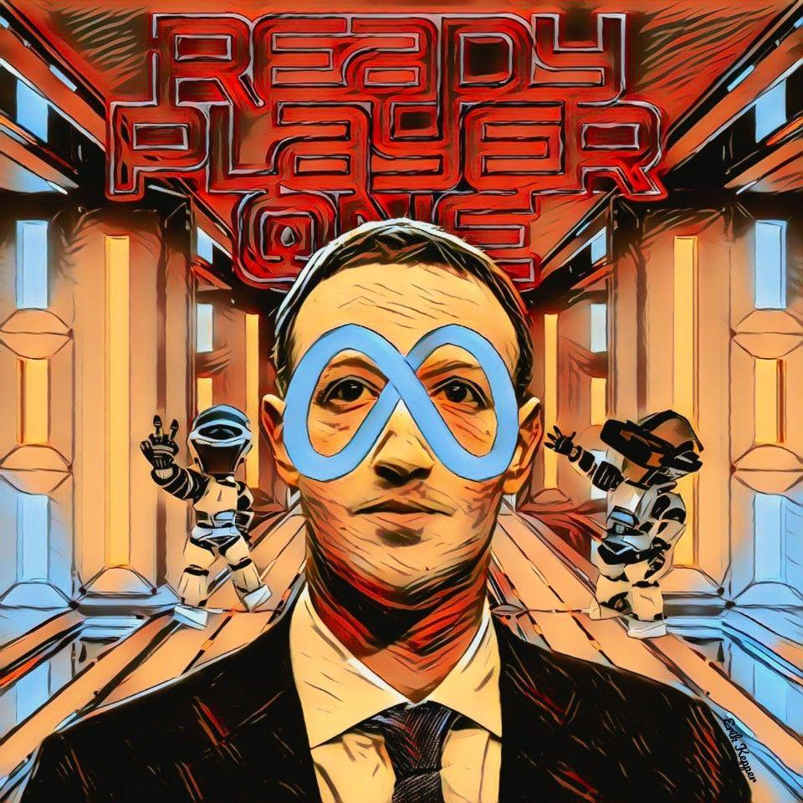
At the end we hope for the best as prescribed by Mark Zuckerburg about the Metaverse and future of web

